Slide 1

IBM Project Presentation on “One Stop Solution for Billboard Advertising Rates”
By
Group ID: G01
Under the guidance of Prof. Umang Thakkar (Internal Guide)
& Mr. Prakash Agrahari (External Guide)
Institute of Computer Technology, Ganpat University
Date: 8 April 2023
Team Member Details
Prutha Vagh 19162101027 CBA | Devarsh Kayastha 19162171017 CS | Raj Chhabria 19162121003 BDA

Slide 2
Table of Contents
Introduction
Background
Collection of the Dataset
Implementation Details
Services, Tool and Techniques used
Scanning
Coding and other implementation details
Working
References

Slide 3
Introduction
One Stop Solution for Billboard Advertising Rates
The advertising industry has been rapidly evolving, and billboard advertising is still one of the most effective ways of promoting products and services. However, one of the main challenges for advertisers is the lack of transparency and consistency in billboard advertising rates. There is a need for a one-stop solution that provides accurate pricing information and allows advertisers to select the most cost-effective options.

Slide 4
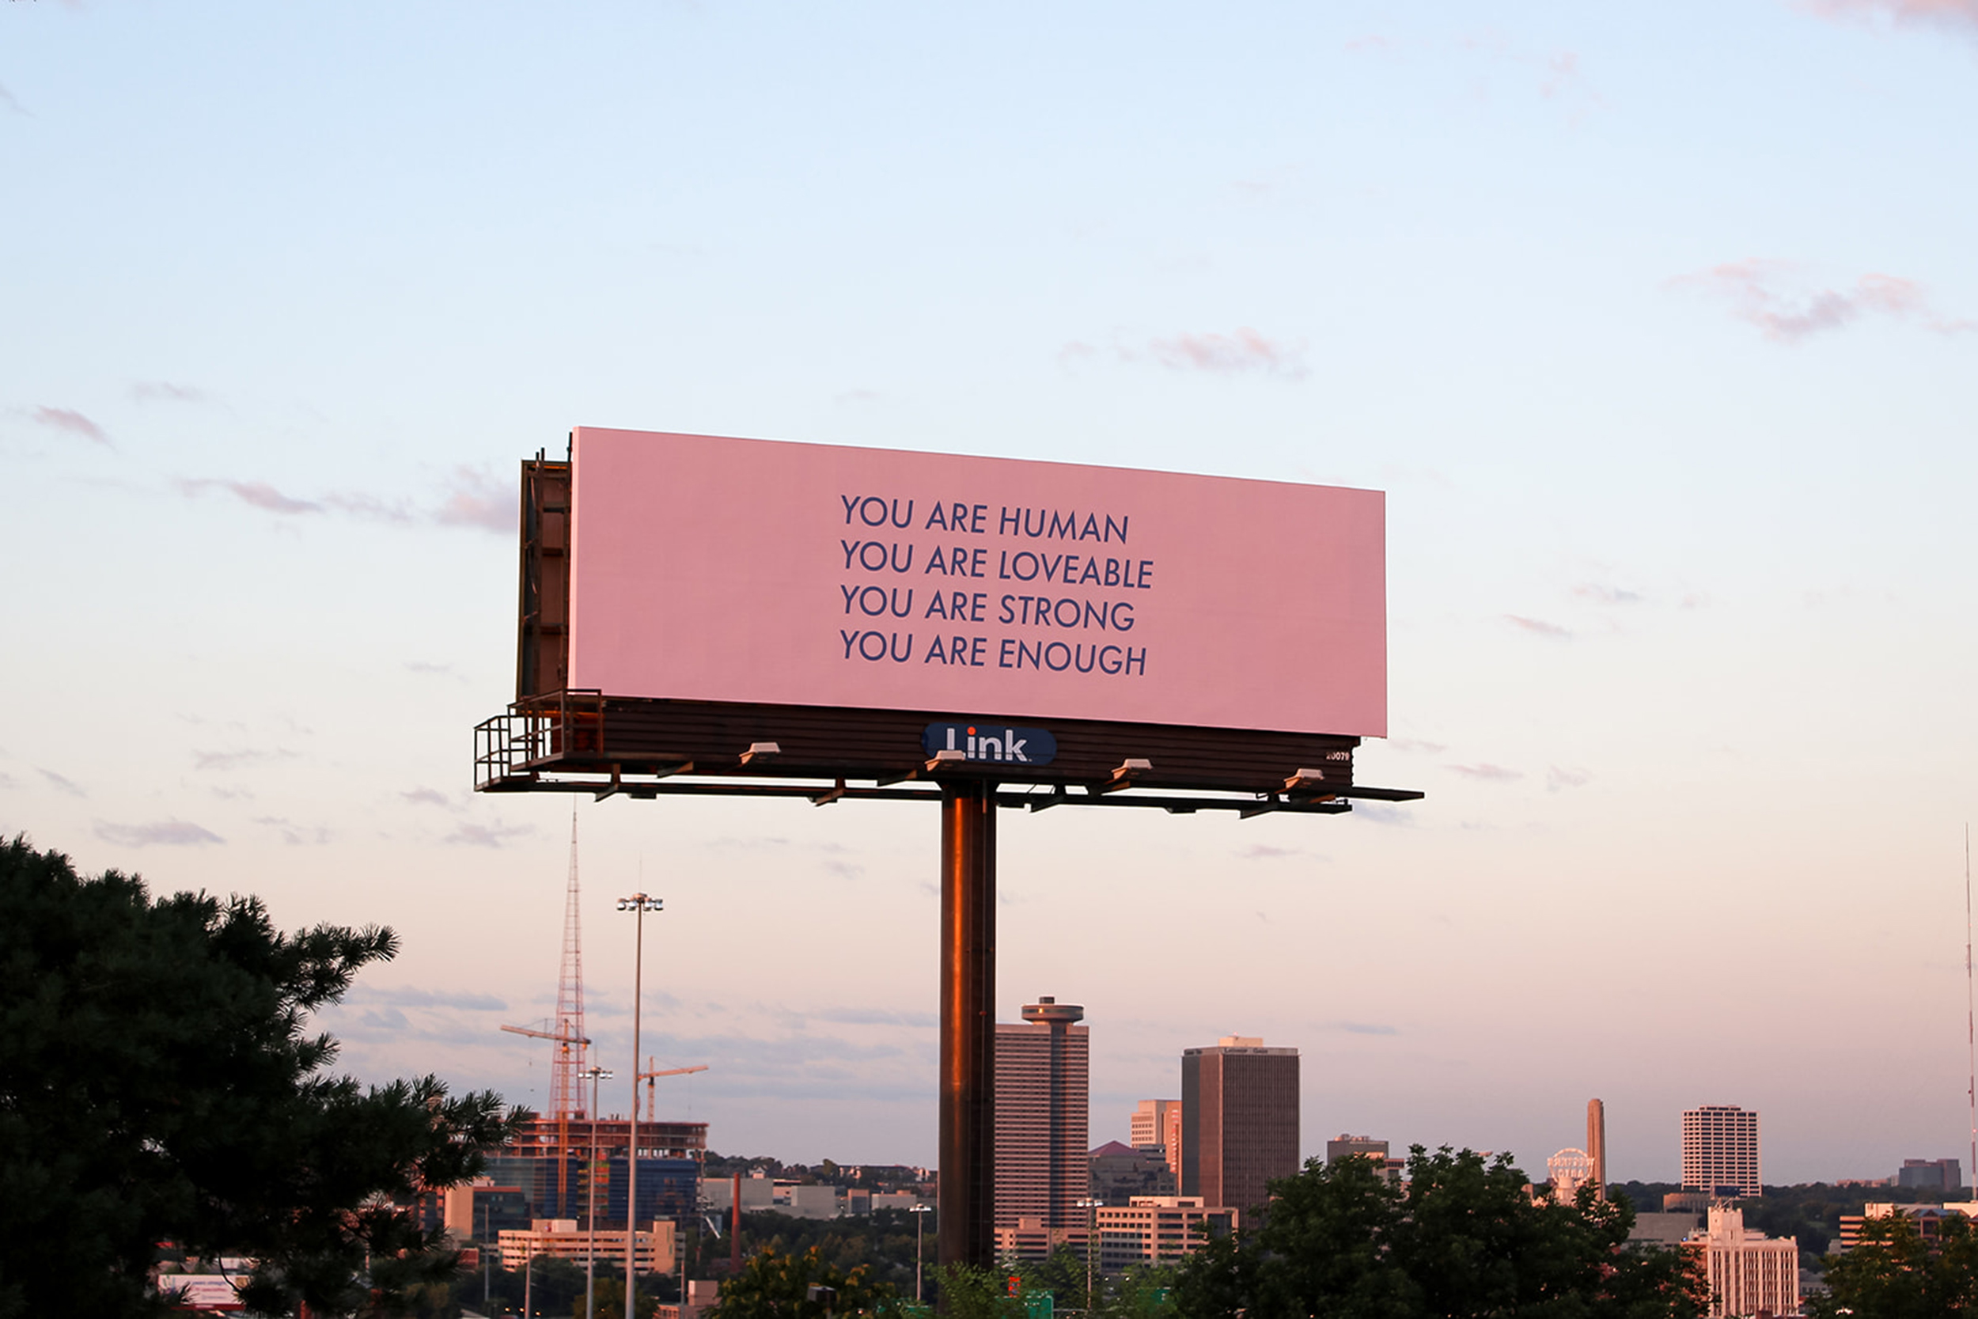

Slide 5
Background
Billboards are a popular and effective form of outdoor advertising that involves displaying large-scale advertisements in prominent locations, such as along highways, in urban areas, and at events. Billboards typically feature high-impact visuals and concise messages to capture the attention of passersby and communicate the advertiser's message quickly and effectively.
Billboards can be static or digital, with digital billboards offering the flexibility to display multiple ads and change content frequently. Advertisers can choose from various types of billboards, such as standard billboards, bulletins, posters, and walls cape, to suit their specific needs and budget.

Slide 6
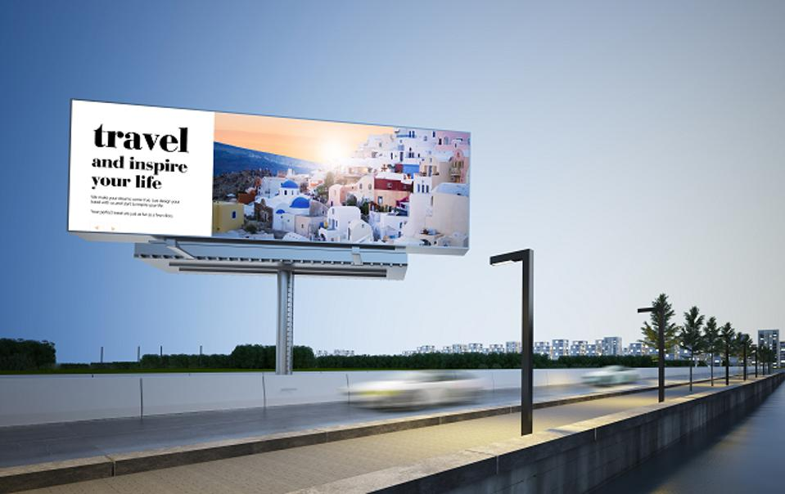

Slide 7
Collection of the Dataset
We have taken the all the areas of “Ahmedabad” city.
User can select the Billboard on the basis of:
Area
Type
Height and Width
No of Days
Duration

Slide 8
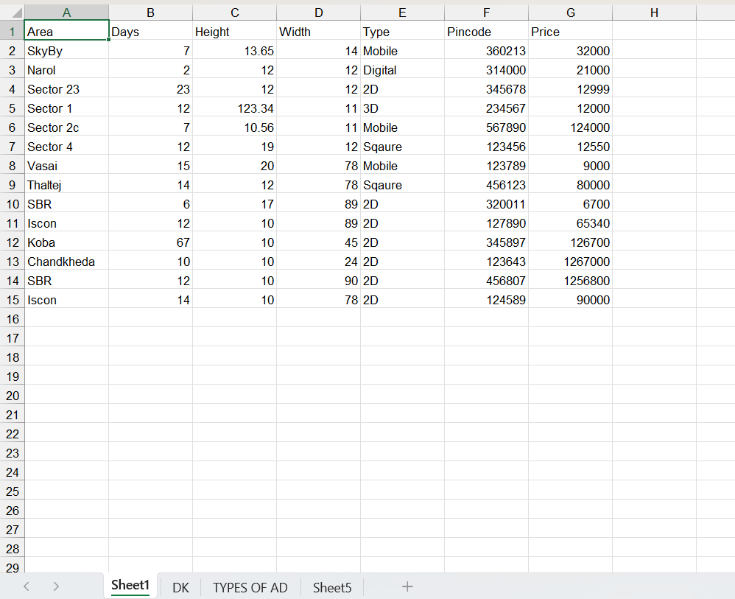

Slide 9
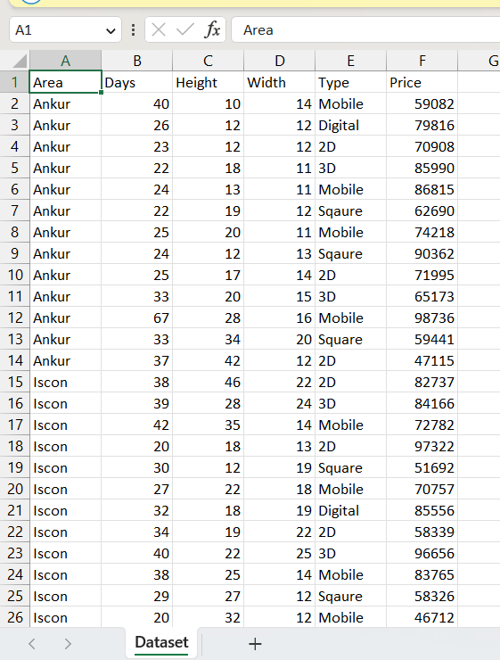

Slide 10
Implementation Details
Literature Reading
Understanding
Collecting the dataset
Applying Machine Learning
Working on the Model Design.
The Front-end panel is been made using Streamlit.
Applying different ML models.

Slide 11
Collection of the Dataset
We prepared a dataset for a particular city covering all the areas.
User can find their needs by entering:
Area
Height & Width
Duration
Pin Code
No of Days
And the model will display the accurate price.

Slide 12
Machine Learning
Machine learning (ML) is a type of artificial intelligence (AI) that allows software applications to become more accurate at predicting outcomes without being explicitly programmed to do so. Machine learning algorithms use historical data as input to predict new output values.
We have applied Machine Learning in our dataset and further applied various ML models to find the best one.

Slide 13
Various ML models applied
Regression
Linear Regression
Logistic Regression
Decision Tree
Random Forest
Neural Network
Clustering

Slide 14
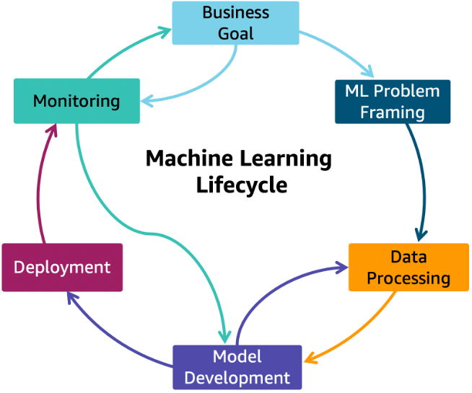

Slide 15
Working
We have designed a web application using Streamlit for front-end part.
Our ML model is running on Backend.
User has to select the area, enter pin code, height and width and the model will be displaying the price based on it.

Slide 16
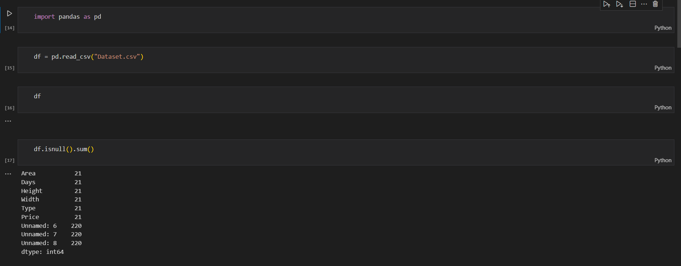
Scanning

Slide 17
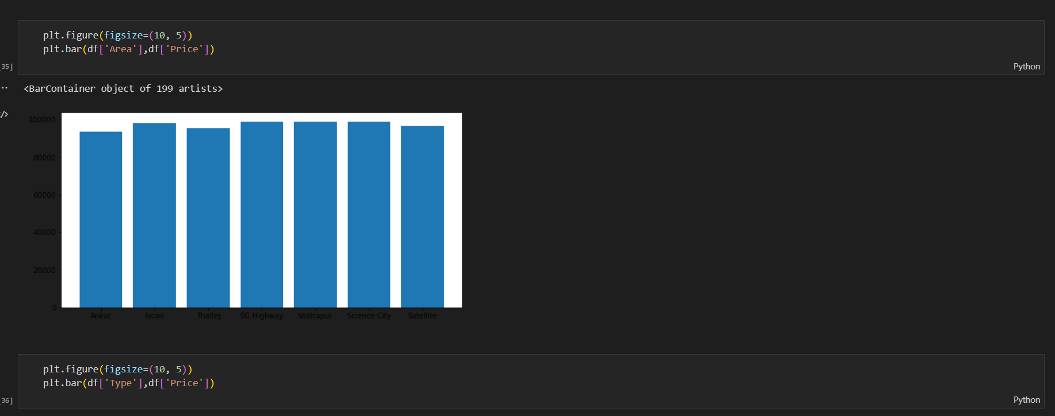

Slide 18
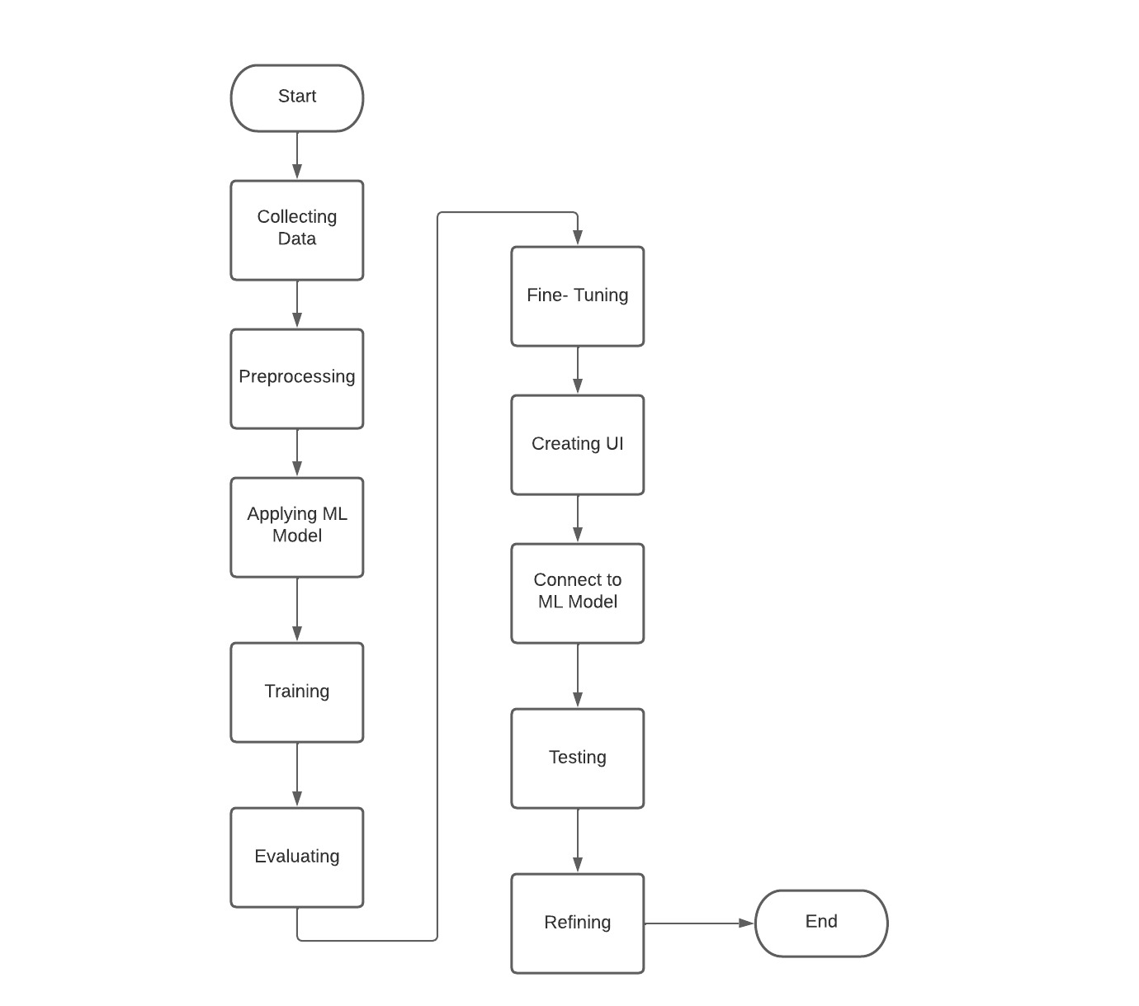
Activity Diagram

Slide 19
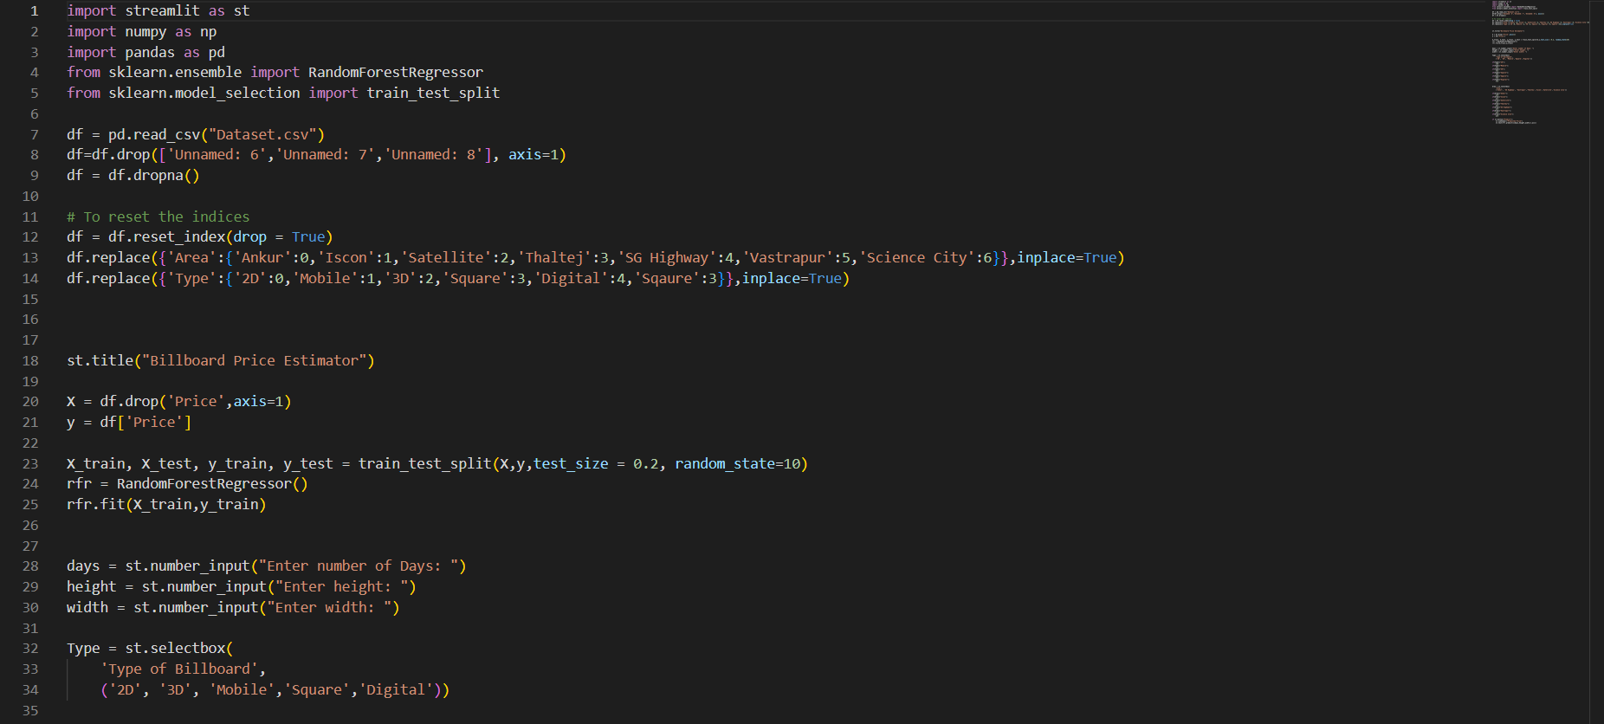
Coding

Slide 20
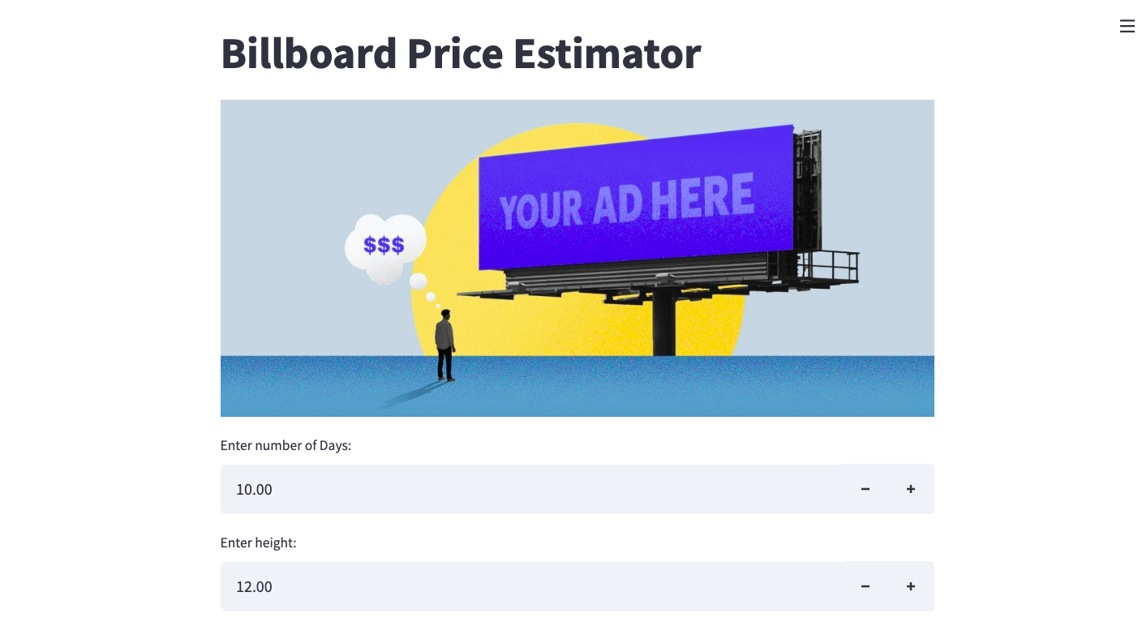
Final Output

Slide 21
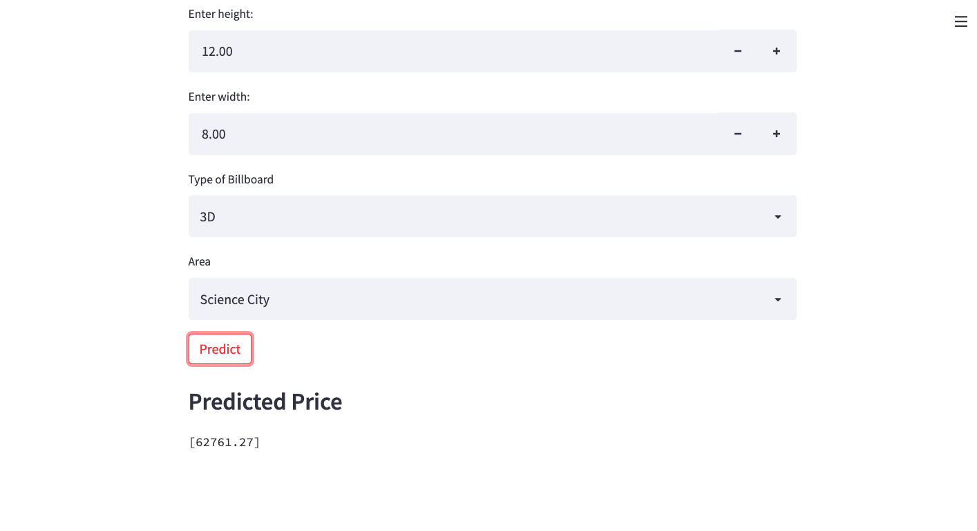

Slide 22
References
https://www.geeksforgeeks.org/machine-learning/
https://stackoverflow.com/
https://www.behance.net/search/projects/?search=billboard%20de
sign
https://streamlit.io/
https://aws.amazon.com/getting-started/hands-on/?getting-started
-all.sort-by=item.additionalFields.content-latest-publish-date&gettin
g-started-all.sort-order=desc&awsf.getting-started-category=*all&a
wsf.getting-started-level=*all&awsf.getting-started-content-type=*
all
https://www.ibm.com/in-en

Slide 23
Conclusion
The project leverages machine learning models to analyze a large dataset of billboard advertising rates and provides valuable insights into the factors that affect advertising rates, such as location, traffic volume, and demographics. This analysis enables businesses to optimize their advertising spend and target the right audiences for their products and
services.

Slide 24
Thank You !!

